Slide 1






ITFA
Intelligent Tax Filing App

Slide 2

APP DESCRIPTION

Slide 3
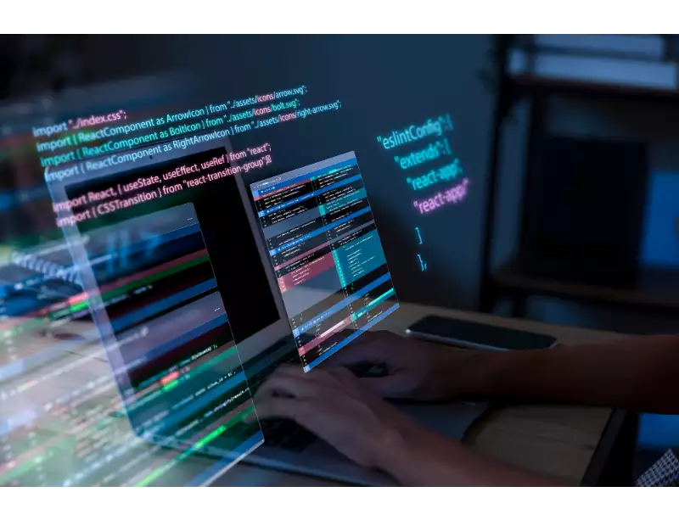
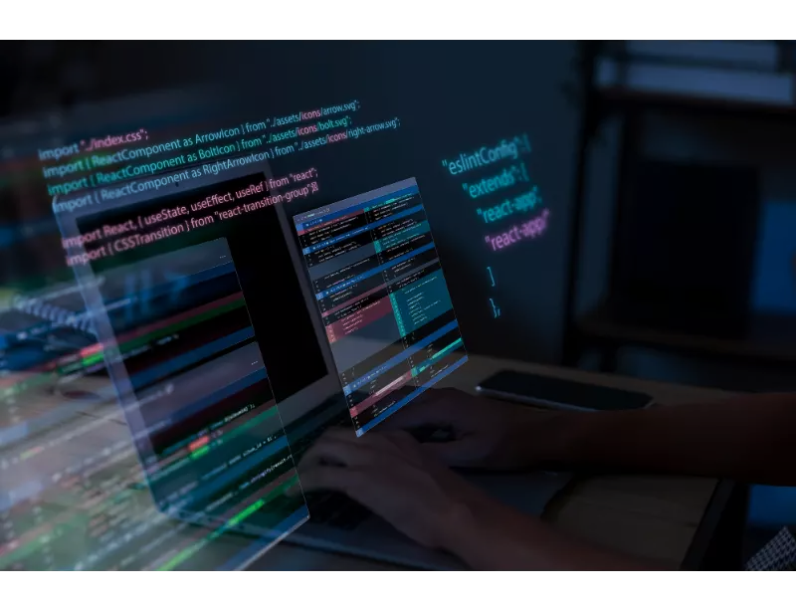
APP DESCRIPTION
ITFA is a simple web app where the user inputs his/her tax information and can get recommendations on how to proceed with it
The main purpose of the app is to showcase my proficiency in developing a full-stack application. It begins with the frontend, where users can input their tax information and receive recommendations on how to proceed. Moving on, I add a backend that includes CRUD APIs to handle data manipulation. Additionally, I integrate the app with the OPEN AI API to enhance its functionality. Finally, I containerize the entire application and utilize GitHub Actions to automate the process of pushing it to Docker Hub. This comprehensive project demonstrates my skills in frontend development, backend implementation, API integration, containerization, and continuous deployment.

Slide 4
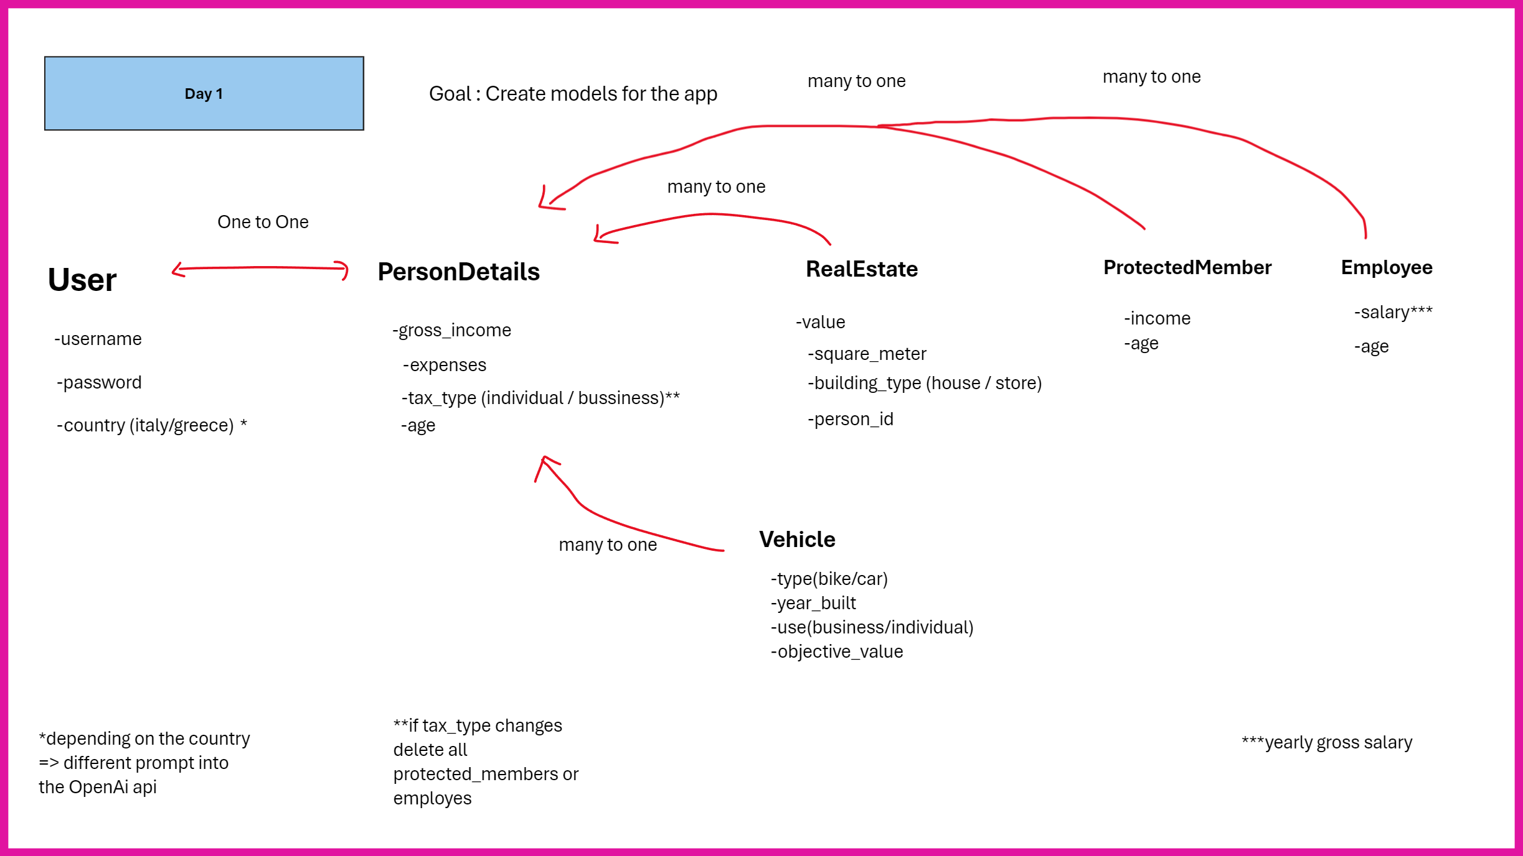
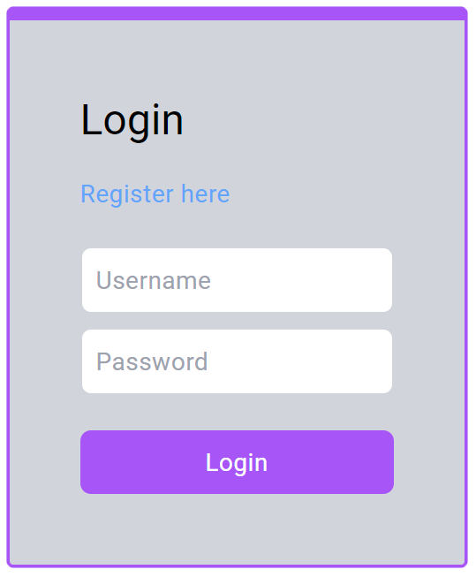

Slide 5

FRONT & BACKEND

Slide 6


FRONT & BACKEND
I developed a full-stack application using Angular for the front-end and Django for the back-end. I set up a structured Angular front-end, creating a responsive home page with a brief description of the application. I implemented a user-friendly form for users to input basic tax information. For the back-end, I used Django to set up a robust service, creating RESTful API endpoints to handle form submissions and return responses. Finally, I integrated the front-end form with the back-end service, enabling seamless data exchange and processing between the two.

Slide 7
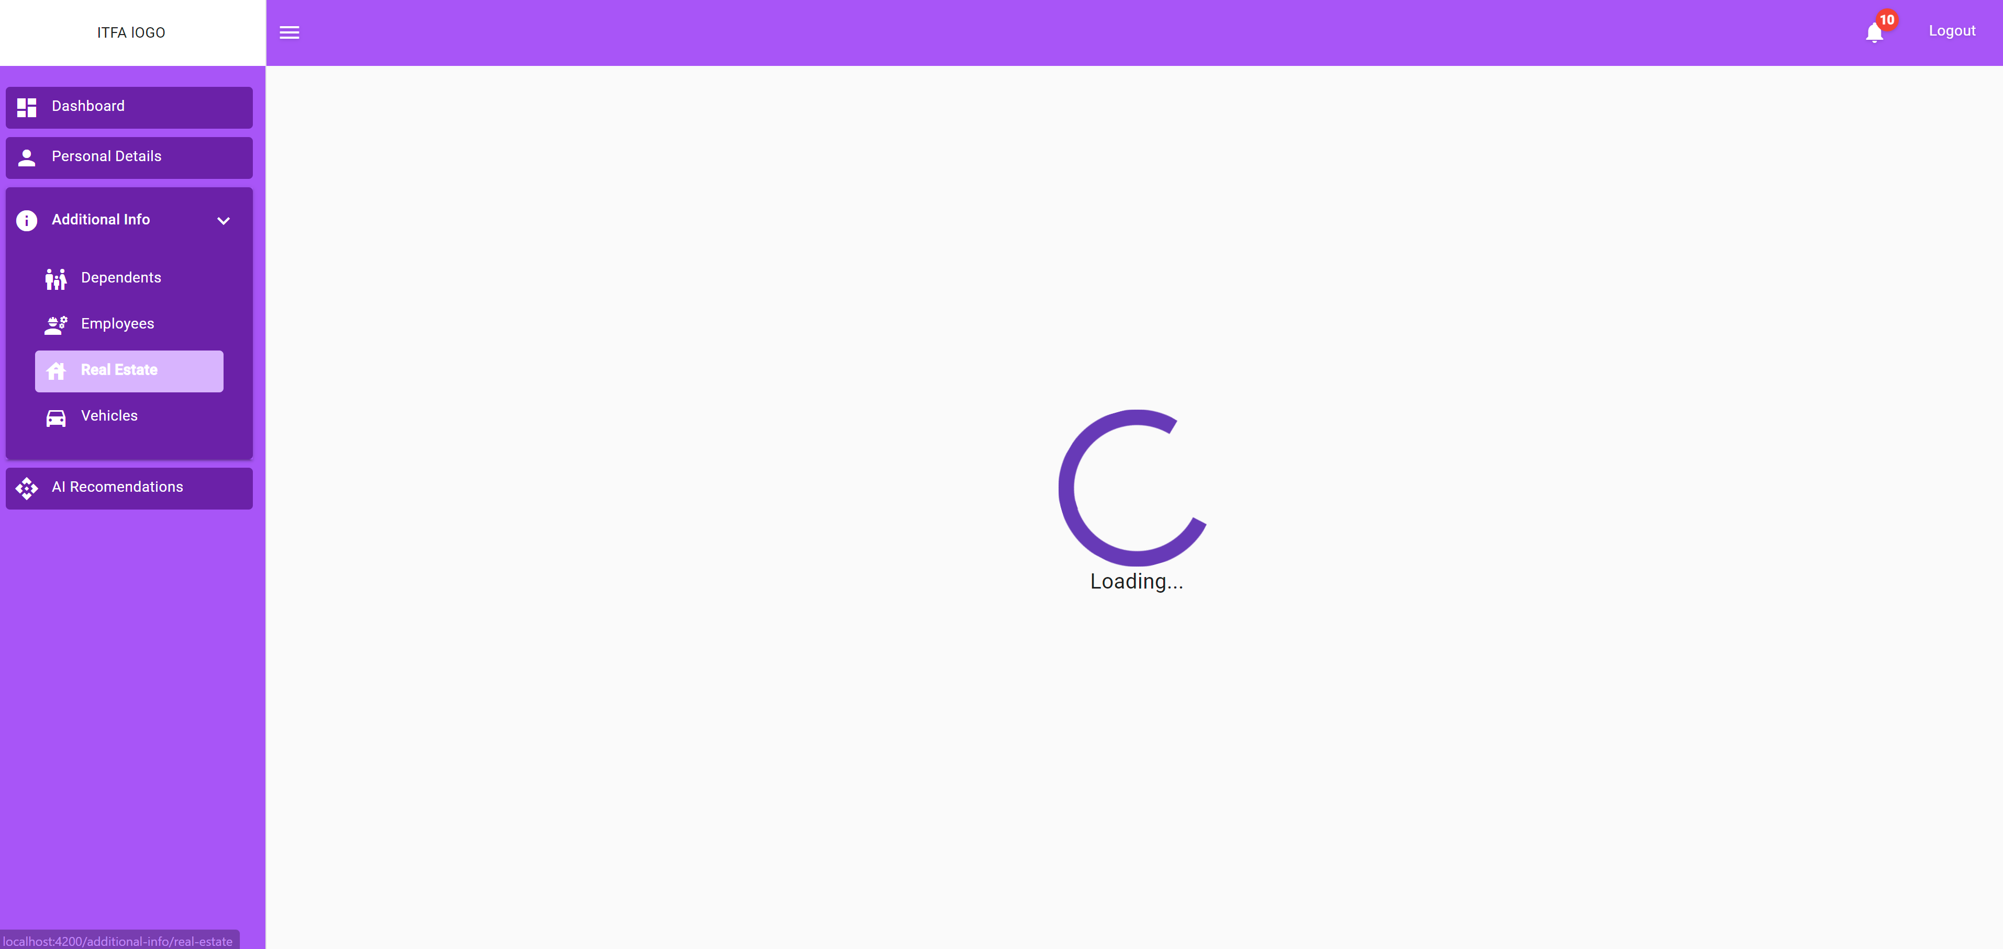
First, user authentication is required

Slide 8
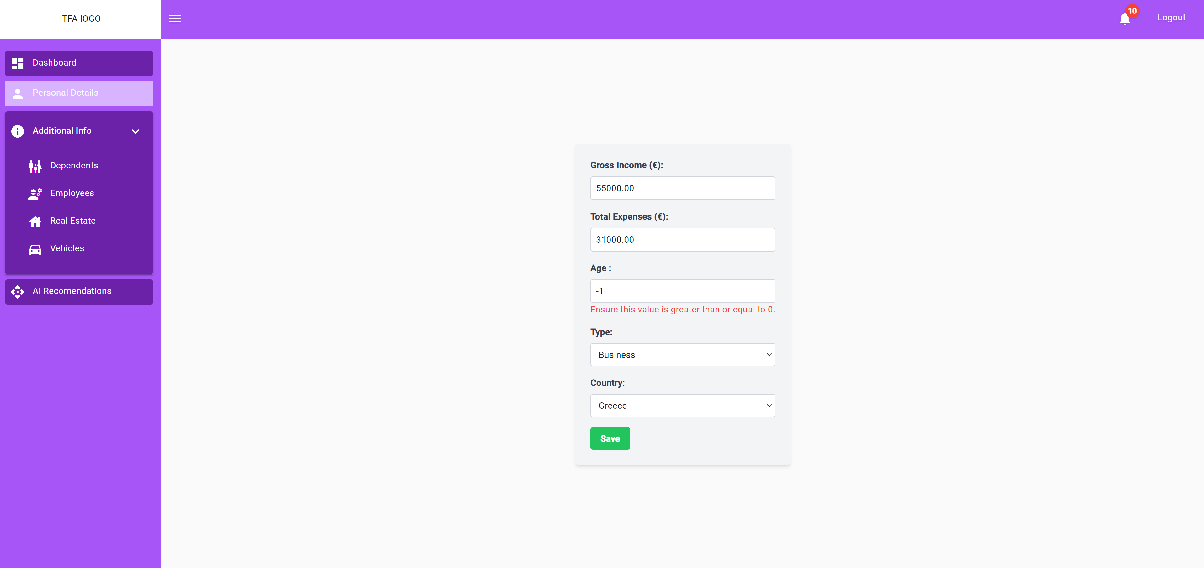
Personal Details: The user enters the basic information.
Of course, the necessary validity check of the data entered is carried out

Slide 9
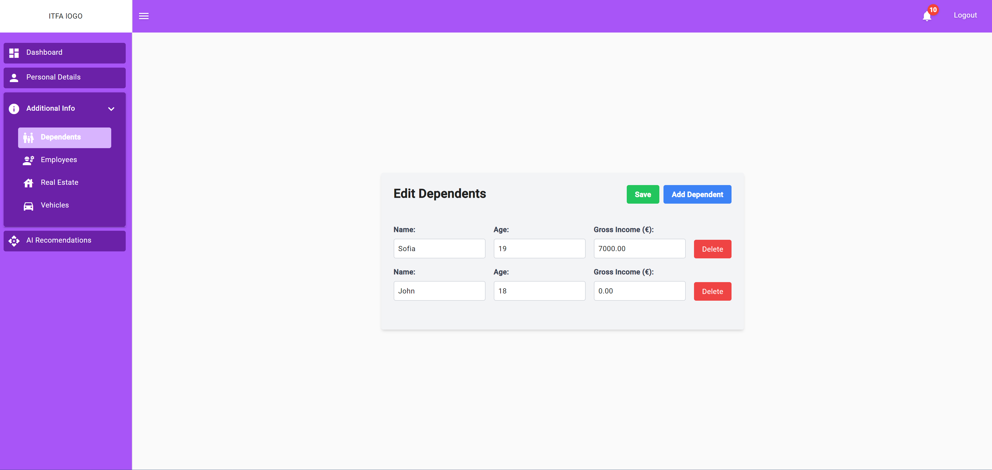
Then, through various forms, the necessary information is entered such as: Dependents, Employees, Real Estate and Vehicles

Slide 10

AI INTEGRATION

Slide 11


AI INTEGRATION
I integrated a generative AI model using the provided OpenAI API key. I developed a backend service that sends user inputs to the AI model and retrieves personalized tax advice. This advice is then displayed on the web application, providing users with valuable insights. The deliverables include the backend code that integrates the OpenAI API, ensuring seamless interaction between the user inputs and the AI-generated responses.

Slide 12
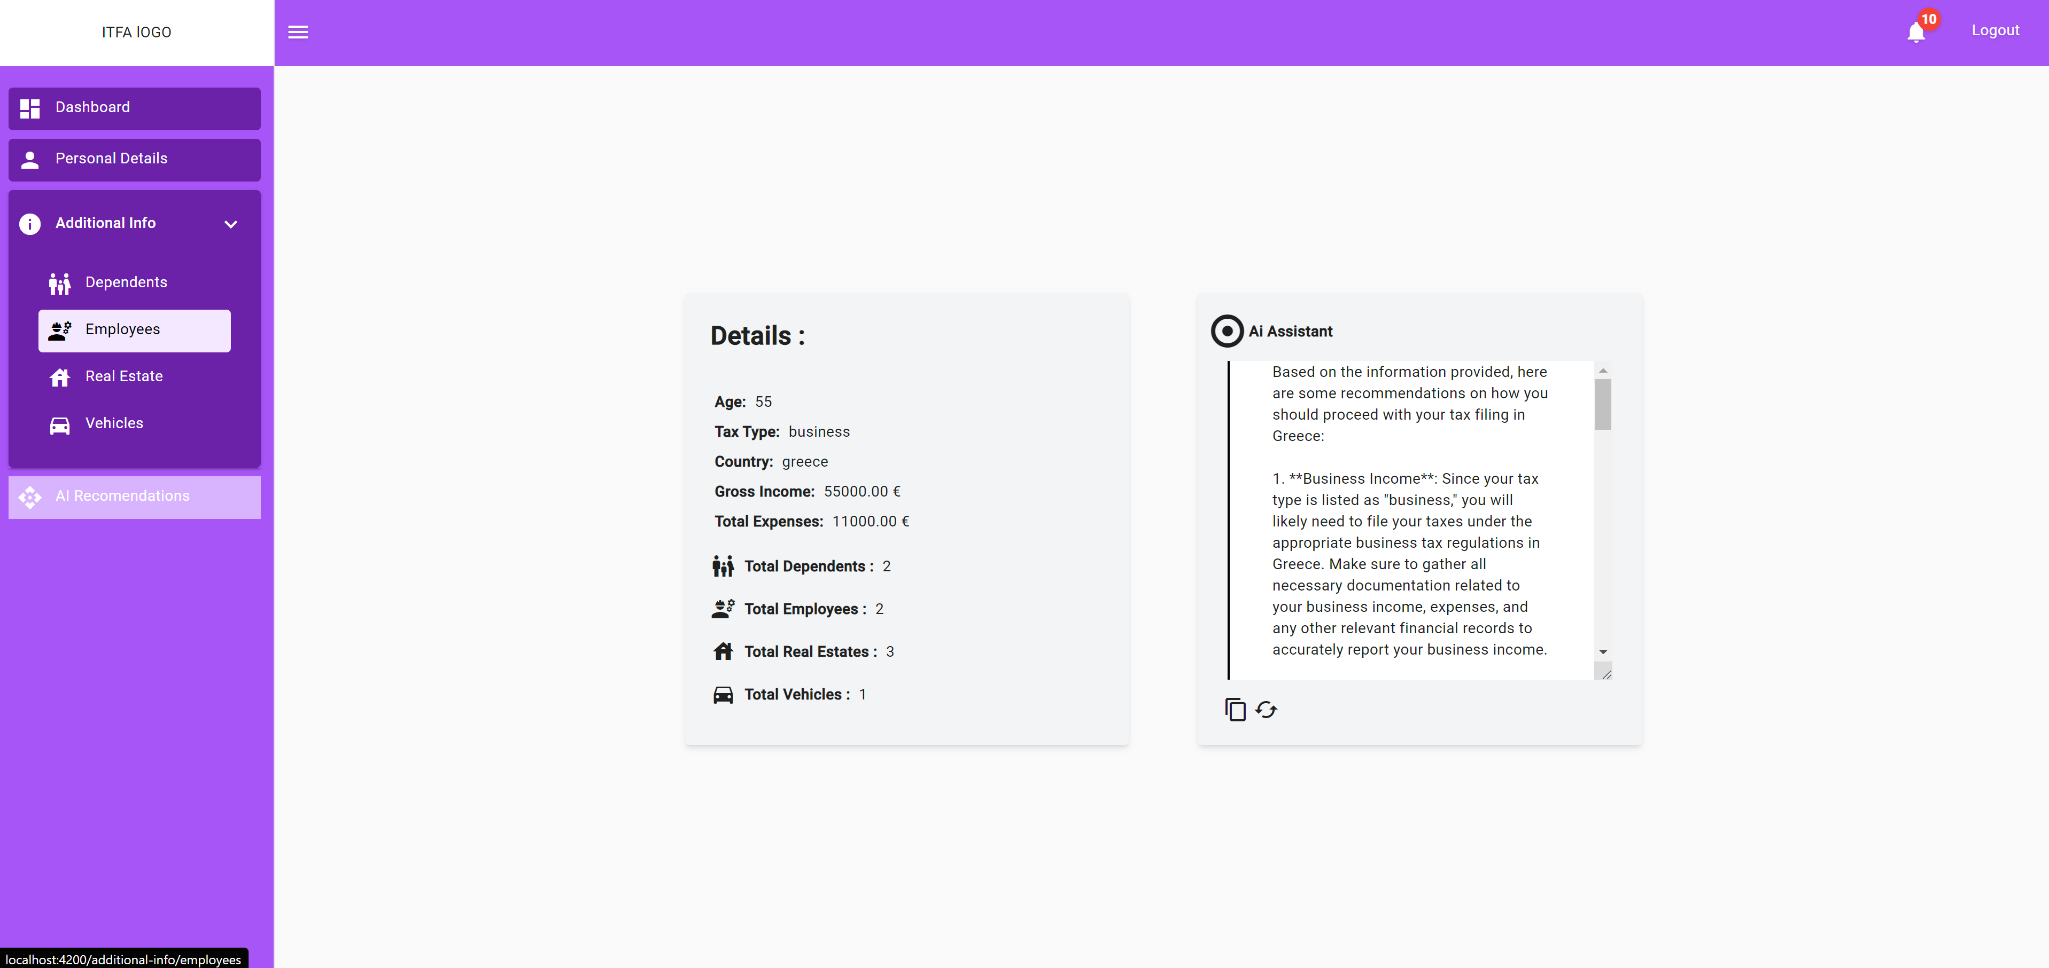
Upon the completion of inputting the necessary information using artificial intelligence, specifically through the use of the Open AI API, recommendations are obtained for improving tax processes.

Slide 13

DOCKER & CI

Slide 14


DOCKER & CI
I containerized both the front-end and back-end components using Docker. I wrote a Dockerfile to ensure the application runs smoothly within Docker containers. The deliverables include the Dockerfile, along with detailed instructions on how to build and run the containers. Additionally, I set up a CI pipeline using GitHub Actions to automate testing and deployment. This pipeline runs tests on each push to the repository and deploys the application if the tests pass.

Slide 15
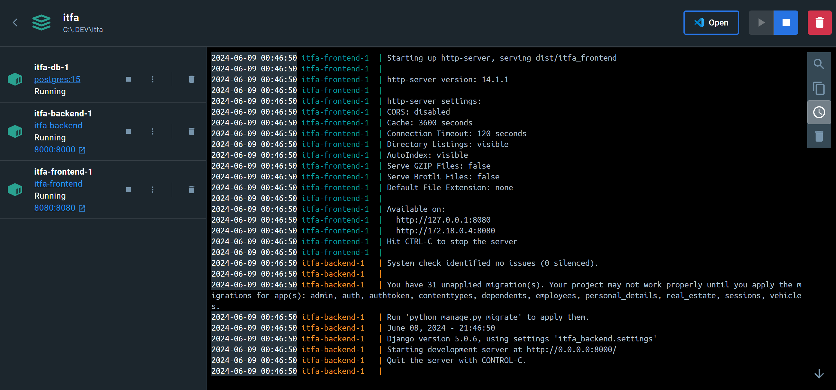
All 3 Images running inside the ITFA Container , working seamlessly with each other.

Slide 16
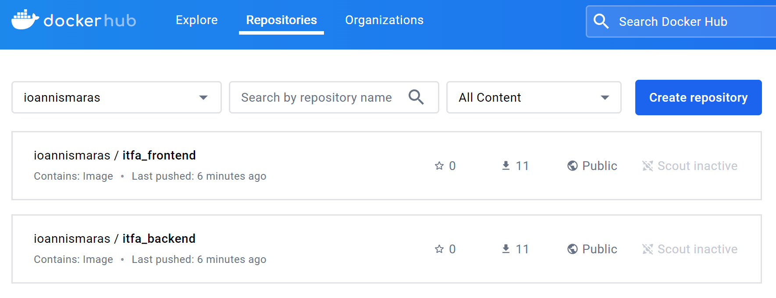
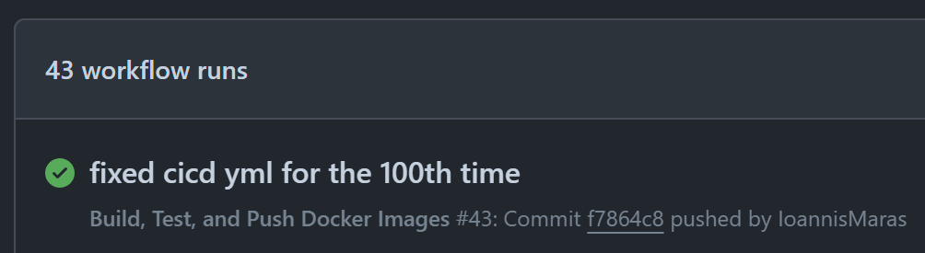
Took me 43 commits but the GitHub actions finally worked and pushed the images to docker hub

Slide 17

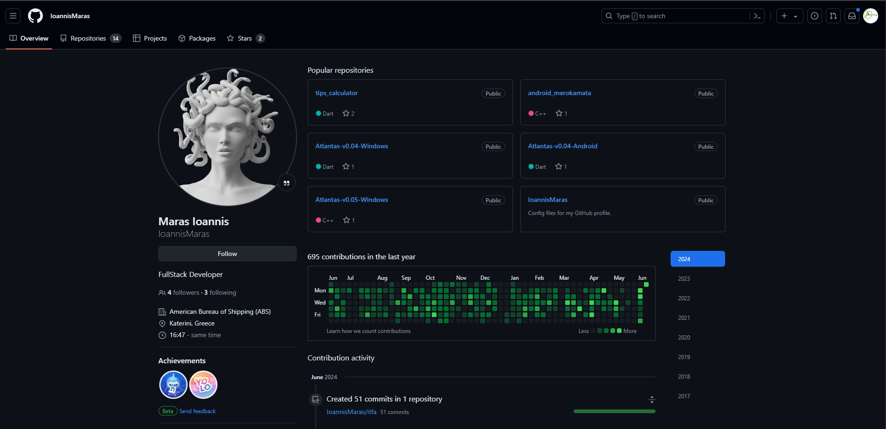


ITFA
Intelligent Tax Filing App
For presentation of ITFA and more info you can visit my GitHub page
More Projects ✨
Follow One Skill
https://github.com/IoannisMaras/

Slide 18
ITFA
Intelligent Tax Filing App
For presentation of ITFA and more info you can visit my GitHub page
Thank you
More Projects ✨
Follow One Skill
https://github.com/IoannisMaras/

